Slide 1
Reducing Readmissions among Diabetic Patients
Predictive Insights for Smarter Discharge Decisions
Presented by:
Mohamed Thalha Ahamed Ali
301418071

Slide 2


Executive Summary
Analyzed 66,000+ diabetic patient records from 130 hospitals
Built a predictive model to flag likely 30-day readmissions before discharge
Best model (Decision Tree) identified 68% of readmissions (high recall)
Prioritizes patient safety, reduces cost, and improves discharge planning
Reduce readmission rate by 5%

Slide 3
Why Reducing Readmission Matters
Metric | Value
Readmission Rate (Medicare) | 17.0%
Avg. Readmit Cost | $15,200
Total savings(5% Reduction) | $7.6B
$26B Annual Cost
Higher Risk for Diabetic Patients
Direct Financial Loss.
Quality of Care
Reputation at Stake
Notes:
Source:
https://hcup-us.ahrq.gov/reports/statbriefs/sb304-readmissions-2016-2020.jsp
https://www.healthcatalyst.com/learn/success-stories/care-transitions-allina-health?

Slide 4
Project Approach
Used real hospital records from 1999–2008 (UCI dataset)
Focused on diabetic patients — 66,222 relevant encounters after cleaning
Prepared dataset with grouped diagnoses, discharge types, and specialties
Applied balancing techniques (under sampling, oversampling, SMOTE)
Trained and evaluated multiple models to predict 30-day readmission risk
Goal Metric: Recall – correctly flag at-risk patients before discharge.

Slide 5
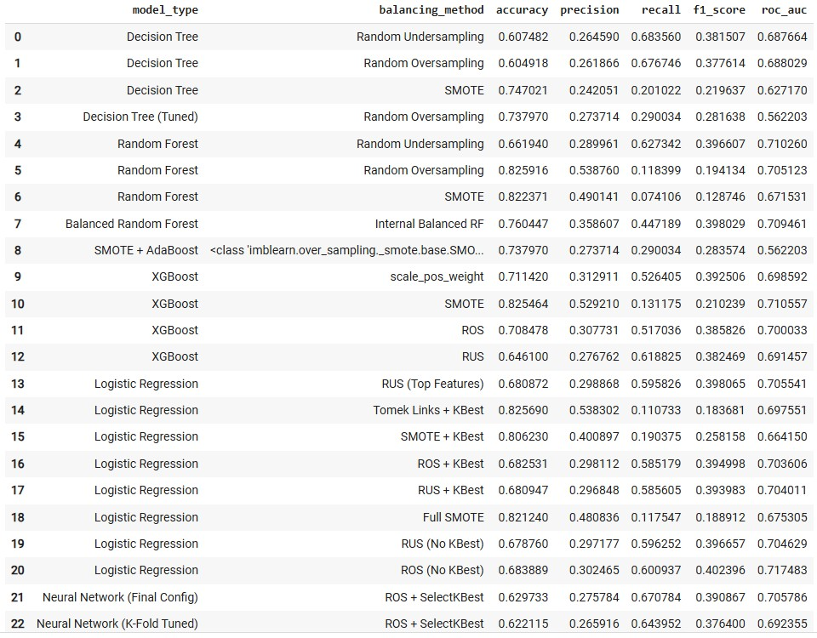
Model Performance – Why We Chose Decision Tree
Tested Multiple Models – Compared Decision Tree, Random Forest, Logistic Regression, and Neural Networks on balanced datasets.
Recall as Priority – Chosen to maximize detection of at-risk patients before discharge, reducing missed cases.
Best Recall: 68% – Decision Tree with Random Undersampling outperformed all other models on our key metric.
Transparent & Trustworthy – Simple, rule-based logic allows clinical teams to understand and validate decisions.
Operationally Practical – Easy to integrate into discharge planning systems and apply in daily workflows without specialized training.

Slide 6
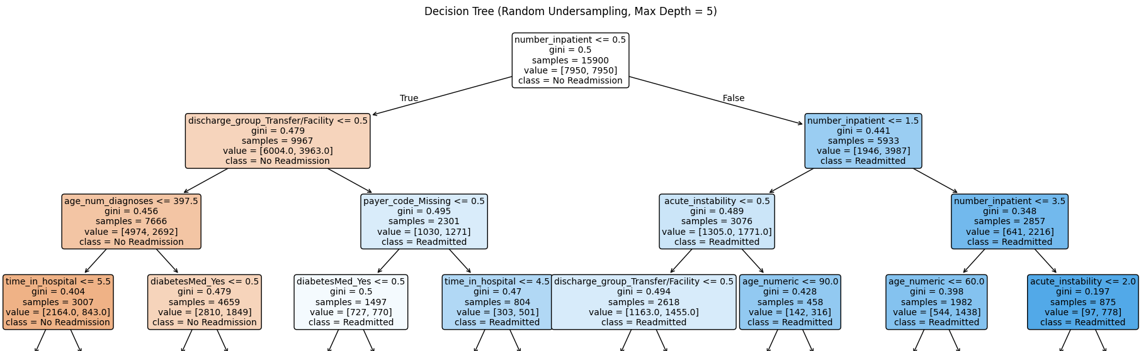
Model Logic – Decision Tree Overview
Simple & Interpretable – Uses clear, clinically relevant rules that align with physician reasoning.
Key Split Points – Prior inpatient visits, discharge type, and diabetes medication use drive most decisions.
Recall-Driven Design – Built to capture the highest number of at-risk patients while staying operationally simple.
Actionable Output – Can be embedded into discharge planning systems to automatically flag high, medium, or low risk.

Slide 7
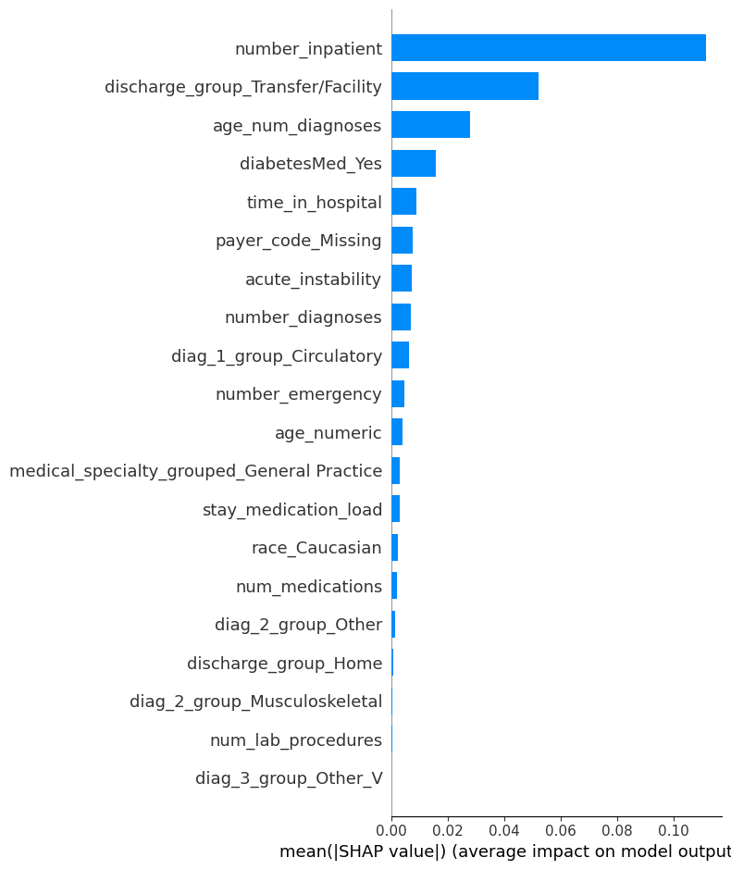
Key Drivers of Readmission Risk
Prior Inpatient Visits – Strongest single predictor; frequent admissions indicate higher likelihood of return.
Discharge Disposition – Transfers to certain facilities are linked to elevated readmission risk.
Age × Number of Diagnoses – Older patients with multiple comorbidities face significantly greater risk.
Diabetes Medication Usage – Signals disease severity and complexity of management.
Length of Stay – Longer hospital stays often reflect complications requiring closer post-discharge monitoring.

Slide 8
Recommendations & Action Plan- Clinical Protocols
Protocol | Specific Actions
1. Enhanced Discharge Plan (Repeat admissions, long stays, older patients with multiple conditions) | Medication reconciliation with pharmacist before discharge Simple, written + verbal discharge instructions reviewed with caregiver Follow-up appointment booked before patient leaves
2. Structured Handover for Facility Transfers (Nursing home, rehab, LTC) | Standardized transfer form including diagnosis, meds, pending labs Nurse-to-nurse handover call within 24 hours Facility to send vitals & symptoms back within 48 hours
3. Diabetes Care Optimization (Insulin + oral meds) | Education on insulin injection, glucose checks, hypoglycemia signs Provide glucometer & insulin supplies Telehealth glucose review within 3 days
4. Early Instability Intervention (Unstable vitals, high treatment intensity) | Enroll in hospital-to-home nurse monitoring program for 7 days Remote vital sign monitoring devices provided In-home nursing visit if readings abnormal

Slide 9
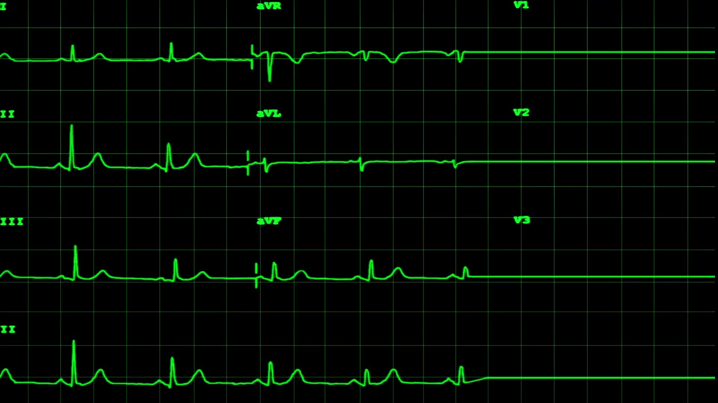
Recommendations & Action Plan- Operational Actions
1. EMR Risk Alerts for High-Risk Discharges
Auto-flag patients with ≥1 prior inpatient visit or discharge to a facility.
Alert triggers “High-Risk Discharge” workflow before orders are signed.
2. Automatic Follow-Up Scheduling
For older patients with ≥5 diagnoses, EMR books a 3-day telehealth or in-person review before discharge.
3. Diabetes Care Pathway Activation
If on insulin + oral diabetes medication, EMR prompts diabetes educator consult, provides glucometer & supplies, and books early glucose review.
4. Long-Stay Discharge Review
For hospital stays ≥5 days, discharge orders require pharmacist, physician, and dietitian approval.
5. Acute Instability Monitoring
Patients flagged “Unstable” are auto-enrolled in 30-day hospital-to-home monitoring with remote vital signs linked to EMR.
6. Facility Transfer Handover Compliance
Dashboard tracks which transfers have nurse-to-nurse handover calls within 24 hrs and vitals returned within 48 hrs.

Slide 10
Model in Action – Real Patient Examples (1 of 2)
👤 James– High Risk
Risk Triggers:
3+ prior inpatient visits
Discharged to skilled nursing facility
On multiple diabetes medications Protocol Applied:
Protocol 1: Enhanced Discharge Plan
Protocol 2: Structured Handover
👤Joseph-High Risk
Risk Triggers:
1 prior inpatient admission
On insulin
Discharged to facility Protocol Applied:
Protocol 1: Enhanced Discharge Plan
Protocol 2: Structured Handover
Protocol 3: Diabetes Care Optimization

Slide 11
Model in Action – Real Patient Examples (2 of 2)
👤 Chen– High Risk
Risk Triggers:
2 prior inpatient admissions
On multiple diabetes medications
High number of lab procedures Protocol Applied:
Protocol 1: Enhanced Discharge Plan
Protocol 3: Diabetes Care Optimization
Protocol 4: Early Instability Intervention
👤Priya - Moderate Risk
Risk Triggers:
1 prior inpatient admission
5+ chronic diagnoses
Discharged home Protocol Applied:
Protocol 1: Enhanced Discharge Plan

Slide 12
What Could Further Improve the Model?
Integrate Real-Time Clinical Data
1
Add Social Determinants of Health
2
Post-Discharge Tracking
3
Expand to other chronic diseases
4

Slide 13
“Better discharges today mean fewer readmissions tomorrow.”
We know the challenge
We have the solution
We’re ready to act

